Slide 1
200 new people a day for 12 months

Slide 2
10,000 new people a day
for 12 months

Slide 3
1000 people a day
50% of them return 2-3 times

Slide 4
1000 new people a day
50% play 10 times for 3 weeks

Slide 5
Target
Growing community of experts who played the game 3-9 months

Slide 6
Game experts are not regular gamers

Slide 7
Game-developed verif. experts
Verif. experts
Gamers
People

Slide 8
Learned Lessons
Direct link to making the world better
Only the naked essence of the problem
Maximize use of visual reasoning
Develop skill over time
Collective Social Intelligence
Constant feedback with creators on impact
Stream of new challenges

Slide 9
Making the world better

Slide 10
Pure puzzle form
Maximize use of visual reasoning
Scale to meaningful problems

Slide 11
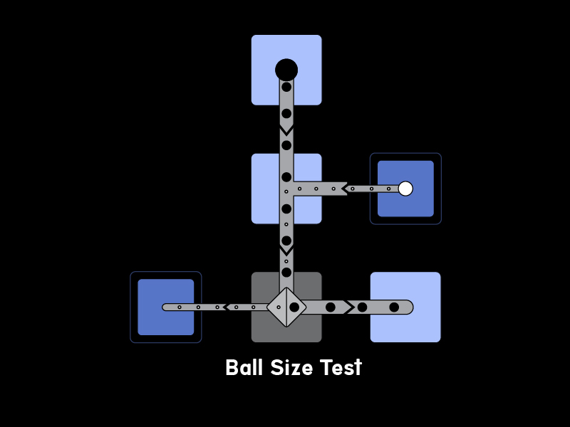
Notes:
“BallSizeTest” in new format

Slide 12
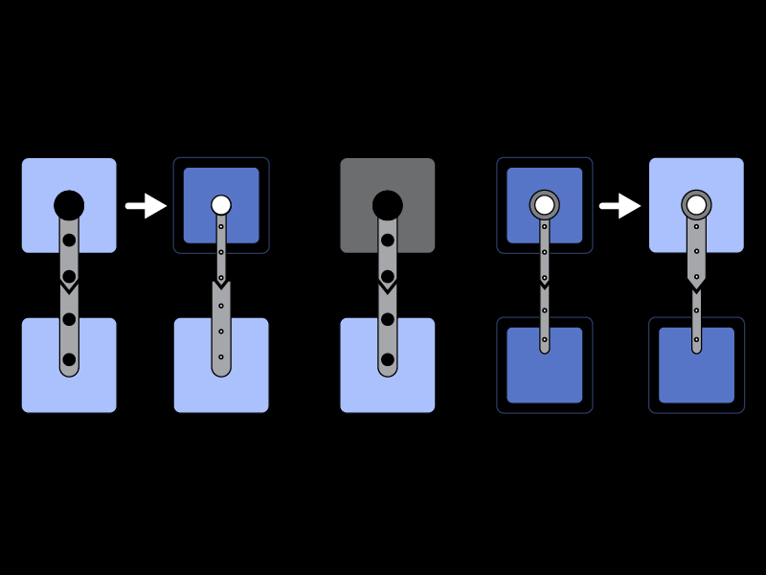
Notes:
Adjusting pipe widths (light blue is large pipe, lark blue is small pipe)

Slide 13
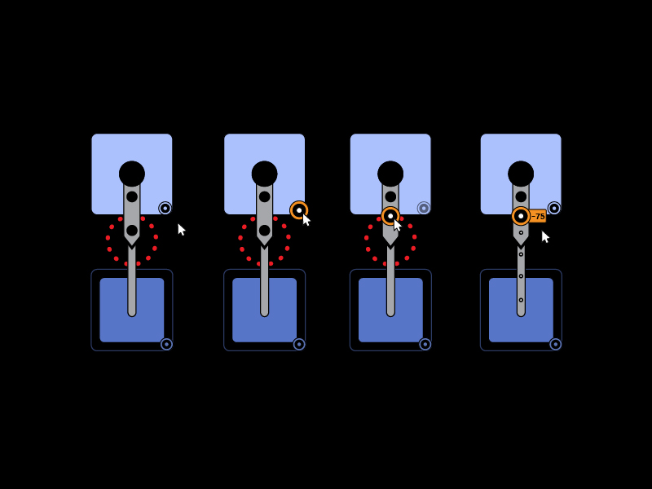
Notes:
Placing a buzzsaw

Slide 14
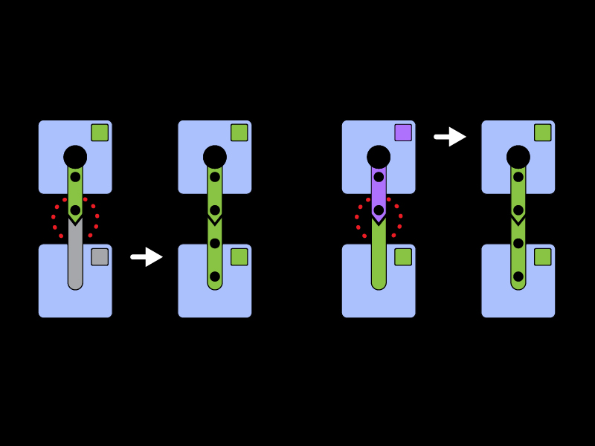
Notes:
Secondary type system = colors
(no longer stars on cars)

Slide 15
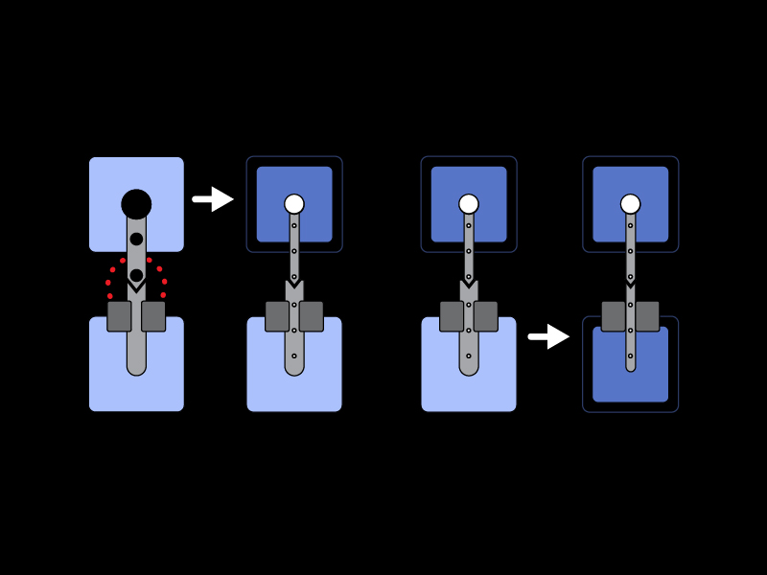
Notes:
Pinch points

Slide 16
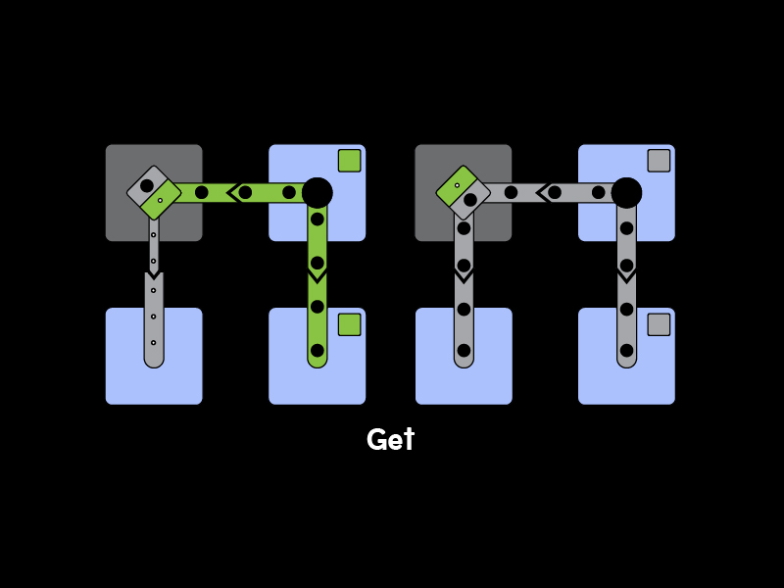
Notes:
Map.Get

Slide 17
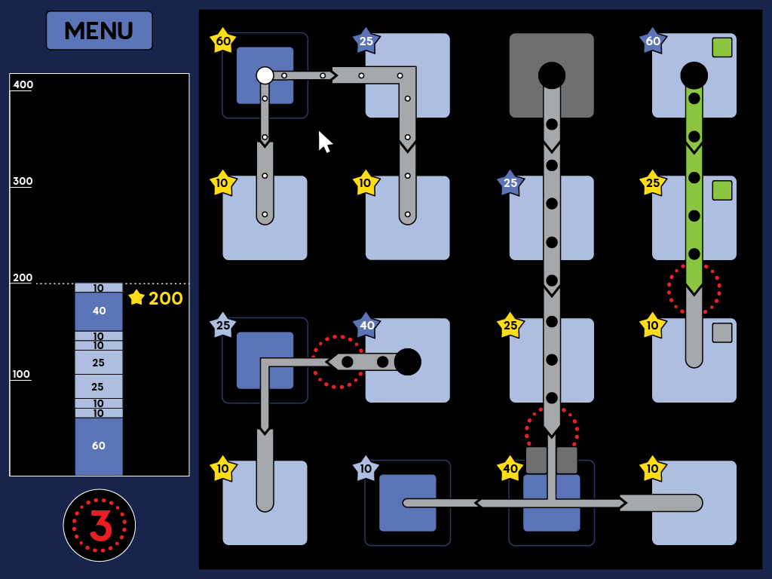
Notes:
Example game board in new style

Slide 18
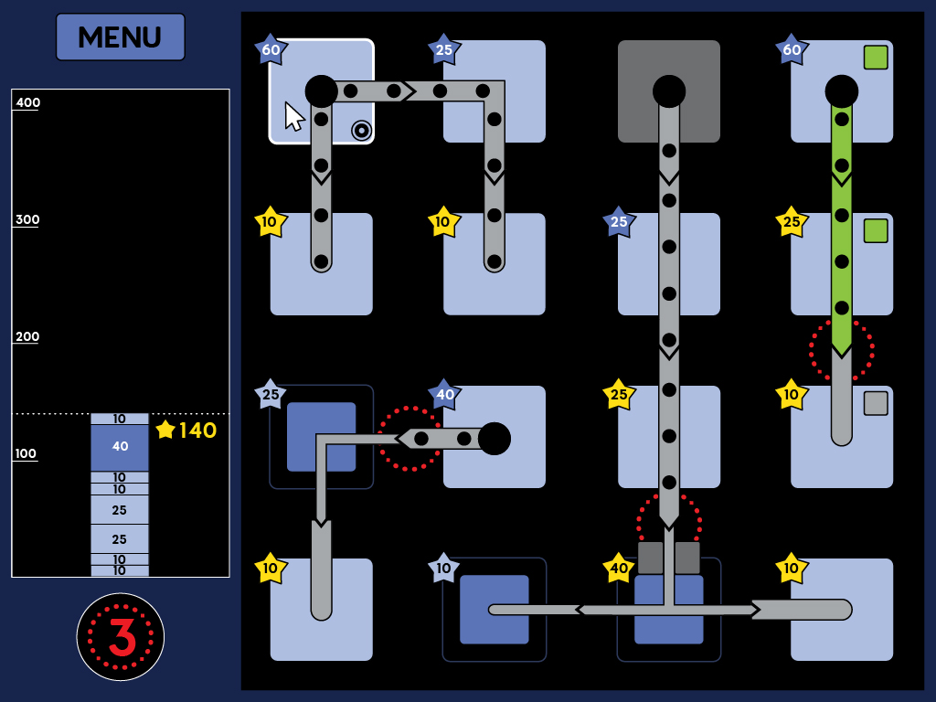
Notes:
Pipe in upper left corner becomes wide

Slide 19
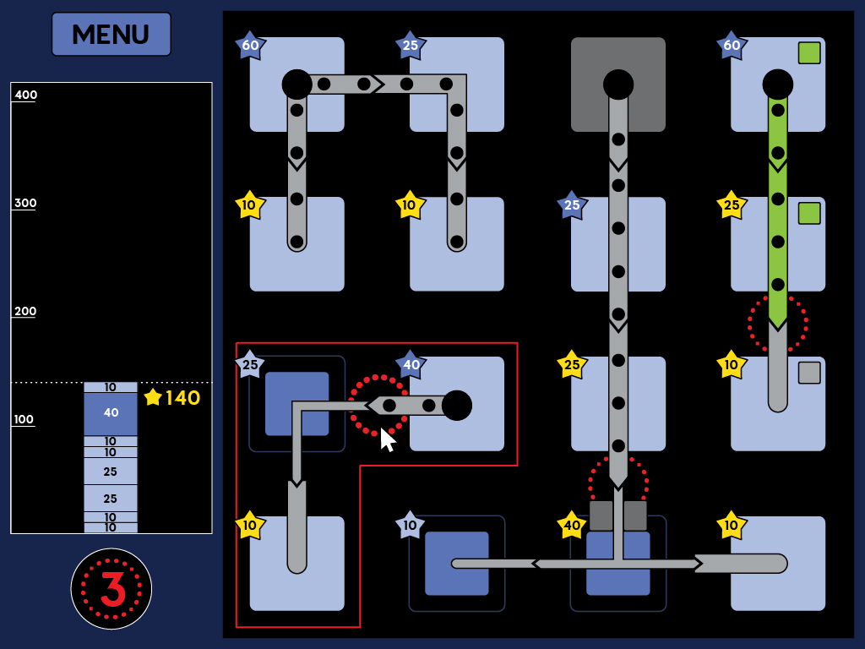
Notes:
Blockage in the lower left

Slide 20
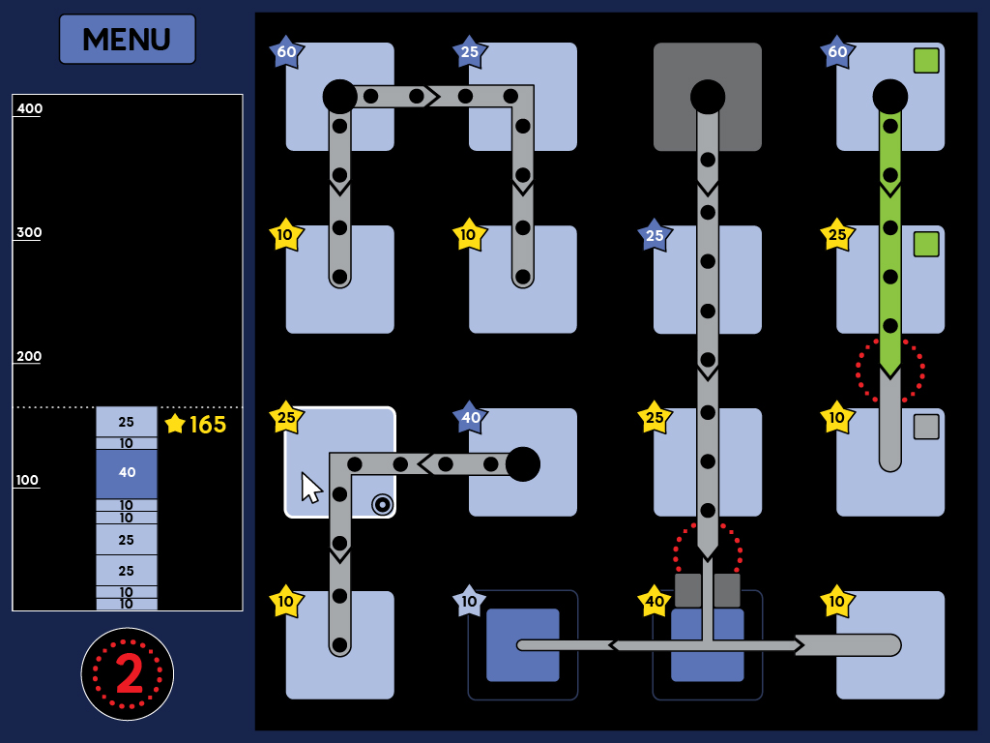
Notes:
Widening the pipe

Slide 21
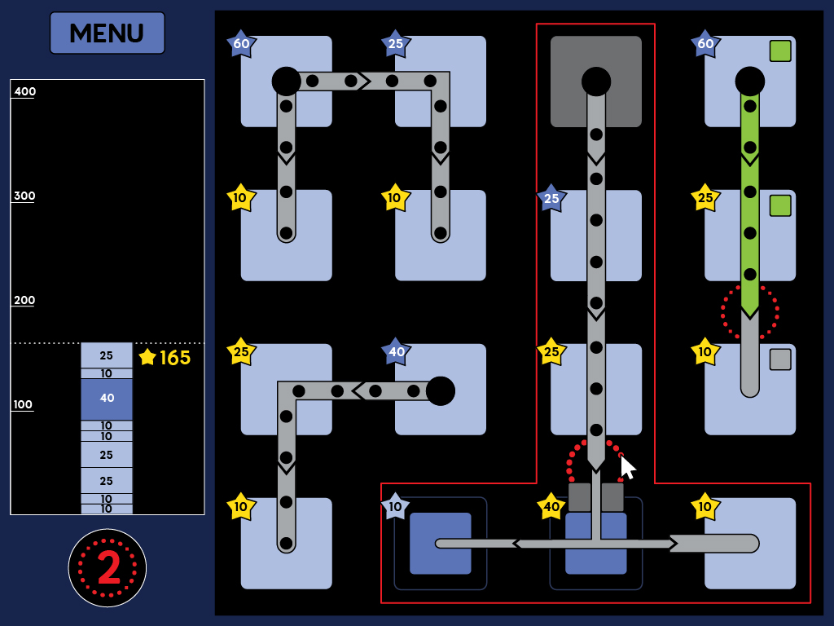
Notes:
Blockage in lower center

Slide 22
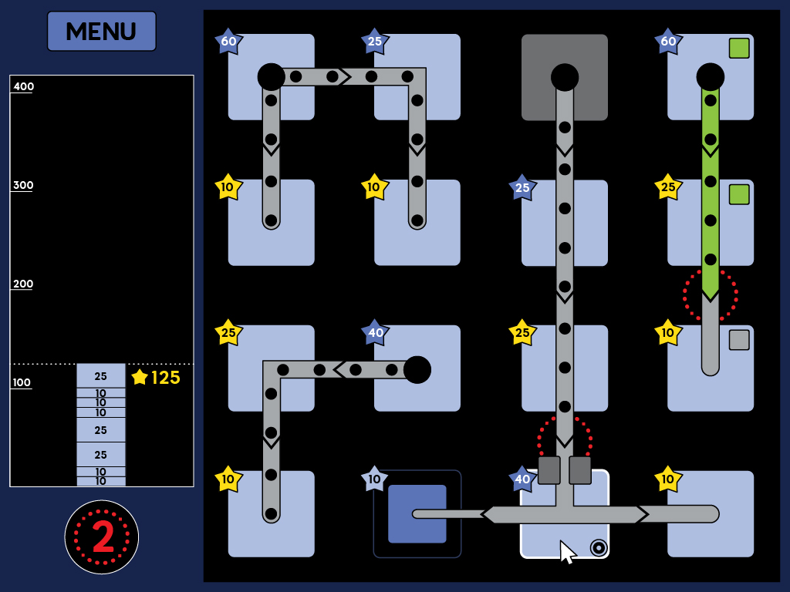
Notes:
Widen pipe

Slide 23

Notes:
Buzzsaw icon

Slide 24
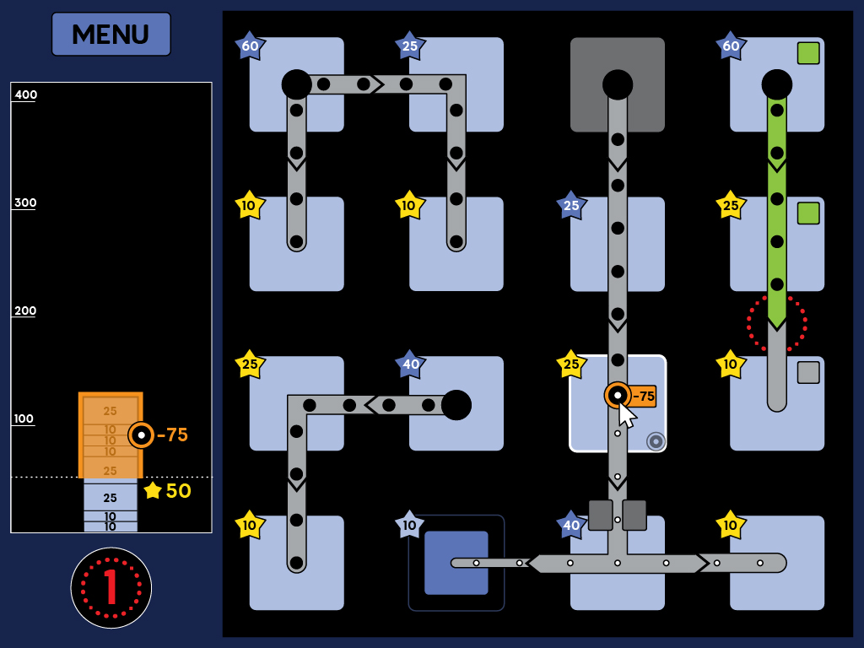
Notes:
Buzzsaw places

Slide 25

Notes:
Problem on right

Slide 26

Notes:
Secondary types

Slide 27
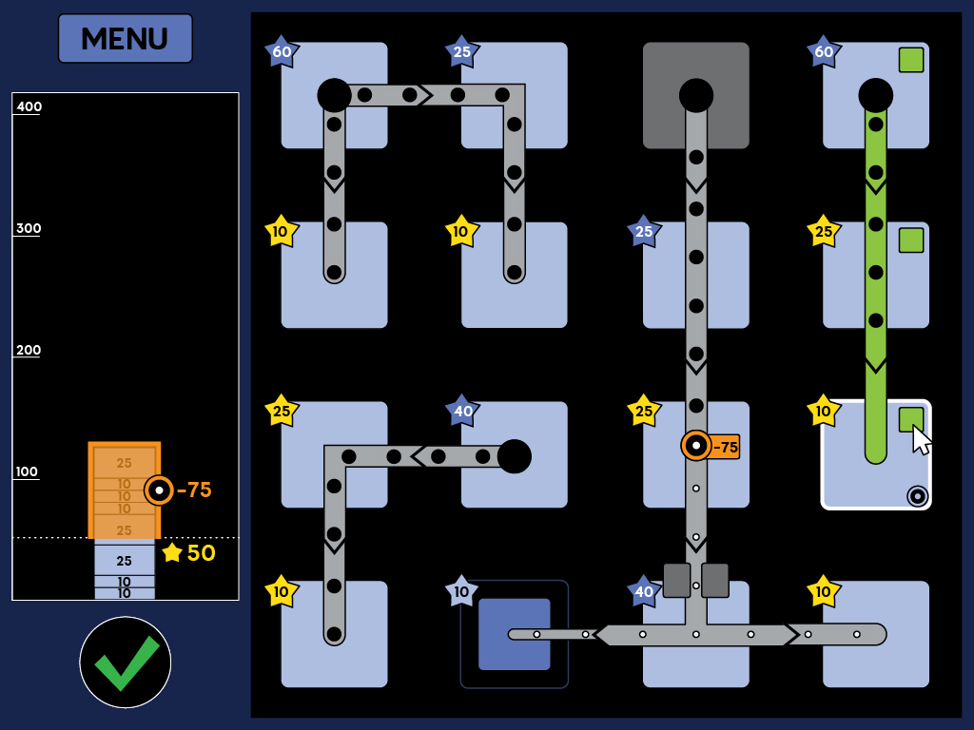
Notes:
Secondary types

Slide 28
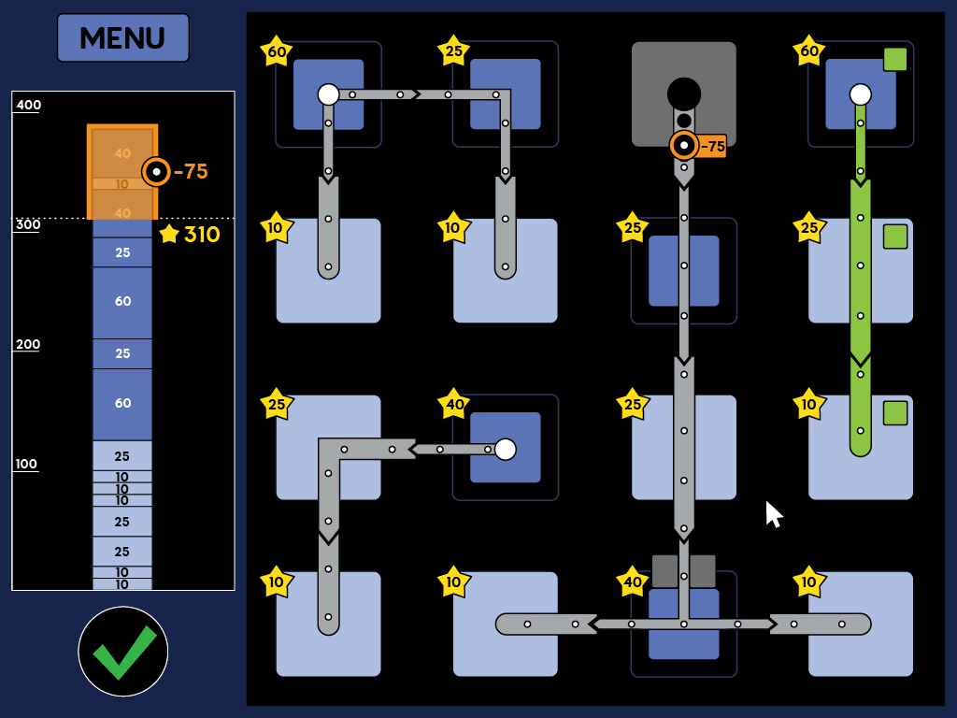
Notes:
Optimal solution

Slide 29
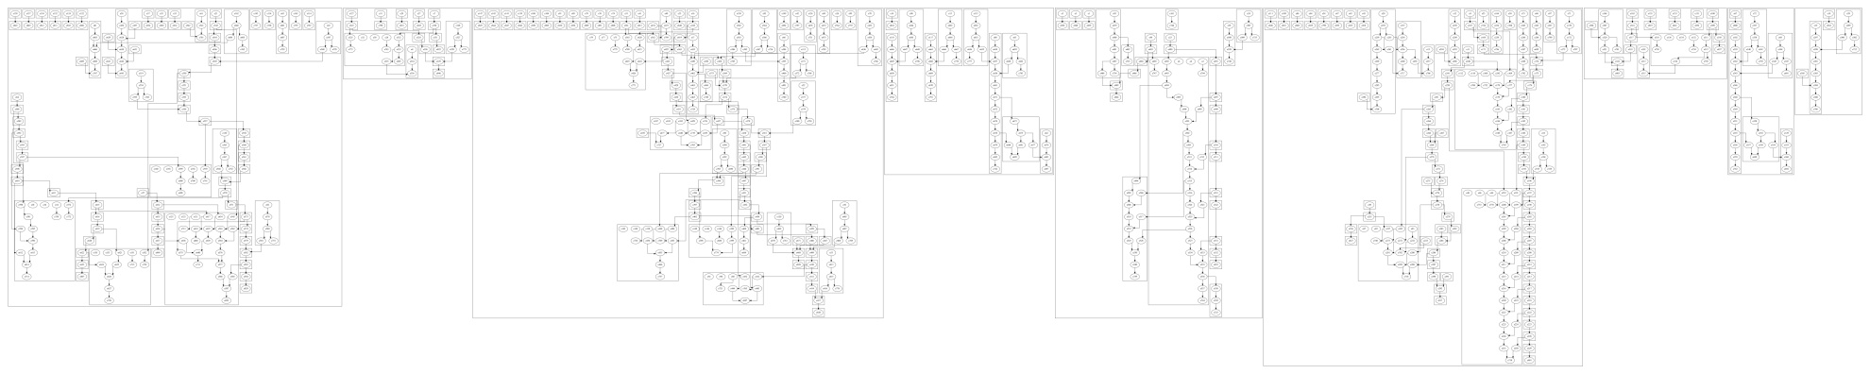

Slide 30
Targeted expertise development

Slide 31
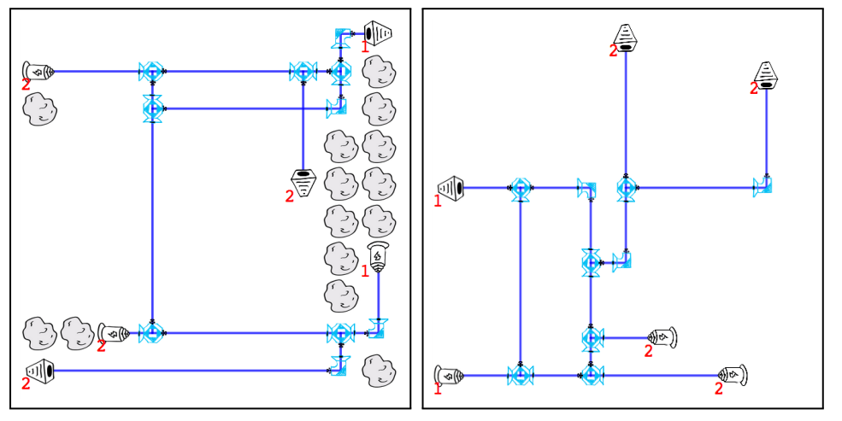
Skill development
Synthetic learning challenges
Automatic generation of problems tailored for each player
ASProlog formulation for challenge synthesis

Slide 32
Collective Social Intelligence

Slide 33
Social Intelligence
Self-organization with complementing skills
Collaboration over competition
Social praise and recognition
Peer-tutoring
Building on skills of earlier players
Community development

Slide 34
Players are changing the game
Constant feedback with creators on impact
Stream of new challenges

